Slide 1


Unit-04 CSS3
Web Designing (WD) (2301CS202)
Prof. Vijay M Shekhat
Department of Computer Science and Engineering
vijay.shekhat@darshan.ac.in
9558045778

Slide 2

Outline CSS
Introduction to CSS3
CSS3 Animations
CSS Variables
Media Queries
Wild Card Selectors
Gradients
Pseudo Classes
Pseudo Element
Tooltip
Looping

Slide 3
Introduction to CSS3
CSS3 is the latest standard for CSS.
CSS3 is completely backwards-compatible with earlier versions of CSS.
CSS3 has been split into "modules". It contains the "old CSS specification" (which has been split into smaller pieces). In addition, new modules are added.
CSS3 Transitions are a presentational effect which allow property changes in CSS values, such as those that may be defined to occur on :hover or :focus, to occur smoothly over a specified duration – rather than happening instantaneously as is the normal behavior.
Transition effects can be applied to a wide variety of CSS properties, including background-color, width, height, opacity, and many more.

Slide 4
Introduction to CSS3 (Cont.)
Some of the most important CSS3 modules are:
CSS Animations and Transitions
Calculating Values With calc()
Advanced Selectors
Generated Content and Counters
Gradients
Webfonts
Box Sizing
Border Images
Media Queries
Multiple Backgrounds
CSS Columns
Courtesy : http://tutorialzine.com/2013/10/12-awesome-css3-features-you-can-finally-use/

Slide 5
CSS3 Animations
CSS animations make it possible to animate transitions from one CSS style configuration to another.
Animations consist of two components,
a style describing the CSS animation
a set of keyframes that indicate the start and end states of the animation’s style, as well as possible intermediate waypoints.
There are three key advantages to CSS animations over traditional script-driven animation techniques:
They’re easy to use for simple animations; you can create them without even having to know JavaScript.
The animations run well, even under moderate system load. Simple animations can often perform poorly in JavaScript. The rendering engine can use frame-skipping and other techniques to keep the performance as smooth as possible.
Letting the browser control the animation sequence lets the browser optimize performance and efficiency by, for example, reducing the update frequency of animations running in tabs that aren't currently visible.

Slide 6
Configuring the animation
To create a CSS animation sequence, you style the element you want to animate with the animation property or its sub-properties. This lets you configure the timing, duration, and other details of how the animation sequence should progress.
Note: This does not configure the actual appearance of the animation, which is done using the @keyframes
The sub-properties of the animation property are:
animation-name : Specifies the name of the @keyframes at-rule describing the animation’s keyframes.
animation-duration : Configures the length of time that an animation should take to complete one cycle.
animation-timing-function : Configures the timing of the animation; that is, how the animation transitions through keyframes, by establishing acceleration curves. (linear, ease, ease-in, ease-out etc…)
animation-delay : Configures the delay between the time the element is loaded and the beginning of the animation sequence.
animation-iteration-count : Configures the number of times the animation should repeat; you can specify infinite to repeat the animation indefinitely.
animation-direction : Configures whether or not the animation should alternate direction on each run through the sequence or reset to the start point and repeat itself. (normal, reverse, alternate etc…)
animation-fill-mode : Configures what values are applied by the animation before and after it is executing.
animation-play-state : Lets you pause and resume the animation sequence.

Slide 7
Defining the animation sequence using keyframes
Once you’ve configured the animation’s timing, you need to define the appearance of the animation. This is done by establishing two or more keyframes using the @keyframes at-rule.
Each keyframe describes how the animated element should render at a given time during the animation sequence.
Example
CSS
p {
animation-duration: 3s;
animation-name: slidein;
}
@keyframes slidein {
from { /* or 0% */
margin-left: 100%;
width: 300%;
} to { /* or 100% */
margin-left: 0%;
width: 100%;
}
}
HTML
<p>
Hello World
</p>

Slide 8
Specifying Intermediate steps
We can specify intermediate steps using percentage of time in @keyframes, similar to the example given below.
HTML
<p>
Hello World
</p>
CSS
p {
animation-duration: 4s;
animation-name: changeColors;
}
@keyframes changeColors {
0% {background-color: yellow;}
25% {background-color: blue;}
50% {background-color: green;}
100% {background-color: red;}
}

Slide 9
CSS Variables / Custom Properties
Custom properties (sometimes referred to as CSS variables or cascading variables) are entities defined by CSS authors that contain specific values to be reused throughout a document.
Advantages of using CSS variables are:
makes the code easier to read (more understandable)
makes it much easier to change.
CSS variables can have a global or local scope.
Global variables can be accessed/used through the entire document.
To create a variable with global scope, declare it inside the :root selector. The :root selector matches the document's root element.
local variables can be used only inside the selector where it is declared.
To create a variable with local scope, declare it inside the selector that is going to use it.
We can use var() function in order to access the variable set in the css.

Slide 10
CSS Variables (Example)
HTML
<p>
Hello World
</p>
<div>
How are you?
</div>
CSS
:root{
--myFavColor : orange;
--myNextFacColor : green;
}
p{
background-color: var(--myFavColor);
color: var(--myNextFacColor);
}
div{
background-color: var(--myNextFacColor);
color: var(--myFavColor);
}

Slide 11
Media Queries
Media queries are a way to target browser by certain characteristics, features, and user preferences, then apply styles or run other code based on those things.
Perhaps the most common media queries in the world are those that target particular viewport ranges and apply custom styles, which is the whole idea of responsive design.
General syntax for the media queries in CSS is,
It consists of:
A media type, which tells the browser what kind of media this code is for (e.g. print, screen etc…).
A media feature, which is a rule, or test that must be passed for the contained CSS to be applied.
A set of CSS rules that will be applied if the test passes and the media type is correct.
Syntax
@media [media-type] ([media-feature]) {
/* Styles! */
}

Slide 12
Media Query (Cont.)
Media Types:
all
print
screen
speech
Media Features:
width & height
min-width, min-height, max-width & max-height
orientation
The viewport meta tag:
<meta name="viewport" content="width=device-width, initial-scale=1.0">
This is needed because by default, most mobile browsers lie about their viewport width.
Non-responsive sites commonly look really bad when rendered in a narrow viewport, so mobile browsers usually render the site with a viewport width wider than the real device width by default (usually 960 pixels), and then shrink the rendered result so that it fits in the display.

Slide 13
Media Query (Example)
CSS
#div1{
background-color: red;
width: 50%;
float: left;
}
#div2{
background-color: yellow;
width: 50%;
float: left;
} @media (max-width: 600px){
#div1{
width: 100%;
}
#div2{
width: 100%;
}
}
HTML
<div id="div1">
Hello
</div>
<div id="div2">
World
</div>
Note: you have to add viewport meta tag in the head section
<meta name="viewport" content=
"width=device-width, initial-scale=1.0">

Slide 14
Media Query (cont.)
We can also use and/or logic in media query, for example
We can use and as a separator if we want two condition to satisfy before applying the CSS.
We can use , (comma) as a separator if we want anyone of the condition to satisfy before applying the CSS.
CSS
@media screen and (min-width: 600px) and (max-width: 900px) {
body {
color: blue;
}
}
CSS
@media (min-width: 600px), (orientation: landscape) {
body {
color: blue;
}
}

Slide 15
Wild Card Selectors
Wildcard selector is used to select multiple elements simultaneously.
It selects similar type of class name or attribute and apply CSS property.
Some of the wild card selector are,
[attribute*=”str”] Selector
It will select all the elements with the given attribute containing the str.
[attribute^=”str”] Selector
It will select all the elements with the given attribute starts with the str.
[attribute$=”str”] Selector
It will select all the elements with the given attribute ends with the str.

Slide 16
Gradients
CSS gradients let you display smooth transitions between two or more specified colors.
CSS defines two types of gradients:
Linear Gradients (goes down/up/left/right/diagonally)
To create a linear gradient you must define at least two color stops.
Color stops are the colors you want to render smooth transitions among.
You can also set a starting point and a direction (or an angle) along with the gradient effect.
Radial Gradients (defined by their center)
The radial-gradient() function sets a radial gradient as the background image.
A radial gradient is defined by its center.
To create a radial gradient you must define at least two color stops.

Slide 17
Linear Gradients
To create a linear gradient you must define at least two color stops.
Color stops are the colors you want to render smooth transitions among.
You can also set a starting point and a direction (or an angle) along with the gradient effect.
direction:
to bottom
to top
to right
to left
to bottom left
180deg
Etc…
Syntax
background-image: linear-gradient(direction, color-stop1, color-stop2, ...);

Slide 18

Linear Gradients (Example)
Example:
Output:
CSS
background-image: linear-gradient(red, yellow);

Slide 19
Radial Gradients
To create a linear gradient you must define at least two color stops.
Color stops are the colors you want to render smooth transitions among.
You can also set a starting point and a direction (or an angle) along with the gradient effect.
shape:
Ellipse (defalt)
Circle
size:
farthest-corner (default)
closest-corner
farthest-side
closest-side
position:
Center (default)
Etc…
Syntax
background-image: radial-gradient(shape size at position, start-color, ..., last-color);

Slide 20
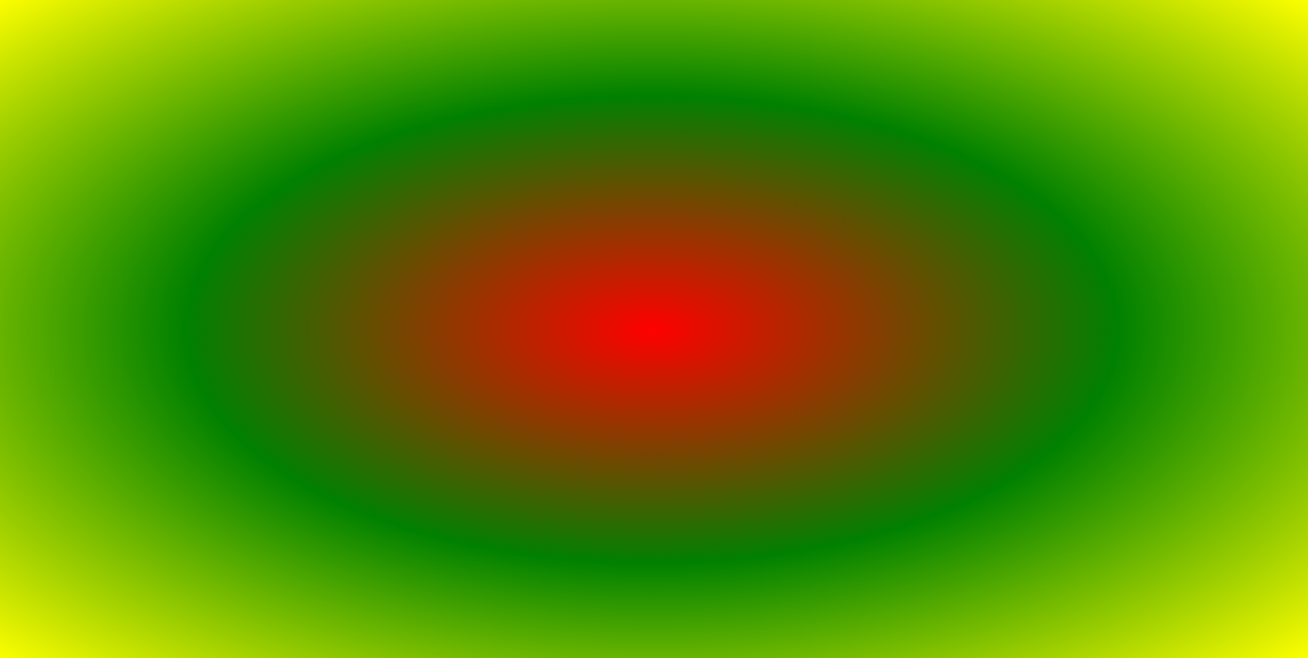
Radial Gradients (Example)
Example:
Output:
CSS
background-image: radial-gradient(red, green, yellow);

Slide 21
Pseudo Classes
A pseudo-class is used to define a special state of an element.
For example, it can be used to:
Style an element when a user mouse over it
Style visited and unvisited links differently
Style an element when it gets focus
Some important pseudo classes are:
active
disabled
first-child
nth-child
focus
hover
visited
Syntax
selector:pseudo-class { property: value; }

Slide 22
Pseudo Elements
A CSS pseudo-element is used to style specified parts of an element.
For example, it can be used to:
Style the first letter, or line, of an element
Insert content before, or after, the content of an element
pseudo elements are,
after
before
first-letter
first-line
selection
Syntax
selector::pseudo-element { property: value; }

Slide 23
Tooltip
A tooltip is often used to specify extra information about something when the user moves the mouse pointer over an element.
HTML
<div class="tooltip">Hover here to see tooltip
<span class="tooltiptext">Tooltip text</span>
</div>
CSS
.tooltip .tooltiptext {
visibility: hidden;
width: 120px;
background-color: black;
color: #fff;
text-align: center;
border-radius: 6px;
padding: 5px 0;
position: absolute;
z-index: 1;
}
.tooltip:hover .tooltiptext {
visibility: visible;
}
CSS
.tooltip {
position: relative;
display: inline-block;
border-bottom: 1px dotted black;
}

Slide 24
Web Designing (WD) (2301CS202)
Prof. Vijay M Shekhat
Department of Computer Science and Engineering
vijay.shekhat@darshan.ac.in
9558045778

